Slide 1
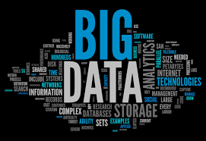
6CS005: Big Data
Jnaneshwar Bohara

Slide 2
Big Data Overview
Collection of data sets so large and complex that it becomes difficult to process using on-hand database management tools or traditional data processing applications.

Slide 3
Big Data
Big data is high-volume, high-velocity and high-variety information assets that demand cost-effective, innovative forms of information processing for enhanced insight and decision making.

Slide 4
From Bits to GeopBytes
1024 Bytes | 1 Kilobyte
1024 Kilobytes | 1 Megabyte
1024 Megabytes | 1 Gigabyte
1024 Gigabytes | 1 Terabyte
1024 Terabytes | 1 Petabyte
1024 Petabytes | 1 Exabyte
1024 Exabytes | 1 Zettabyte
1024 Zettabytes | 1 Yottabyte
1024 Yottabytes | 1 Brontobyte
1024 Brontobytes | 1 Geopbyte
One geopbyte is 1024^10 or1267650600228229401496703205376 bytes. Or simply a 1 followed by 30 digits. (Not zeroes)

Slide 5
Big Data Statistics
2.5 quintillion bytes of data are created each day.
The volume of data created worldwide as of 2023 is 120 zettabytes
147 zettabytes of data are forecasted to be generated in 2024.
Volume of data is expected to reach 181 zettabytes by the end of 2025.
Currently valued at $307.52 billion, the global big data market is predicted to reach $745.15 billion by the end of 2030.
70% of all data across all sectors is user-generated.
Over 97% of businesses worldwide have invested in big data.

Slide 6
Big Data Statistics
Google Gets More than 9 Billion Searches per Day
WhatsApp Users Exchange Over 100 Billion Messages Daily
Every Person-Generated 1.7 Mb of Data per Second in 2020 Alone
Over 95 Percent of Businesses Think that Managing Unstructured Data Is Their Primary Problem
45% of Global Businesses Are Operating a Significant Data Workload On Cloud
With the help of big data, Netflix saves over $1 billion annually with customer retention.

Slide 7
Source of Big Data
Where is all this data coming from?
All sorts of ways:
Activity Data
Conversation Data
Photo and Video Image Data
Sensor Data
The Internet of Things Data
Satellite Data
Astronomical Data
Consider – how much data do you generate?

Slide 8
Activity Data
Simple activities like listening to music or reading a book are now generating data.
Digital music players and eBooks collect data on our activities.
Your smart phone collects data on how you use it
Your web browser collects information on what you are searching for.
Your credit card company collects data on where you shop.
Your shop collects data on what you buy.
It is hard to imagine any activity that does not generate data.

Slide 9
Conversation Data
Our conversations are now digitally recorded.
It started with emails but nowadays even conversations leave a digital trail.
Conversations are not just verbal ones.
Do you use Social Media?
Just think of all the conversations people have on sites like Facebook, Twitter, LinkedIn, etc.
Even many of our phone conversations are digitally recorded.
“Your call may be recorded…..”

Slide 10
Photo and Video Image Data
Do you take a picture on your smart phones or digital cameras?
Digital cameras now come with Wi-Fi!
Do you just store these picture on your device?
No - people upload and share 100s of thousands of them on social media sites every second.
The increasing amounts of CCTV cameras take video images
Bus, train, Asda self scanning machines!
You can see evidence of this when something goes wrong and the Police show pictures from all sorts of CCTV cameras
People up-load hundreds of hours of video images to YouTube and other sites every minute.

Slide 11
Sensor Data
We are increasingly surrounded by sensors that collect and share data.
Think about your smart phone
It contains a global positioning sensor (GPS) to track exactly where you are every second of the day.
It includes an accelometer to track the speed and direction at which you are travelling.
We now have sensors in many other devices and products.
Could this lead to security issues?
Burglars could analyse the data to see if there is a regular slot when your house might be empty

Slide 12
Internet of Things (IoT) Data
We now have:
smart watches, smart fridges and smart alarms.
smart TVs that are able to collect and process data.
Samsung caused worries that their TVs could also listen to your conversations (Guardian 11th Feb 2015):
A line buried in a Samsung Smart TV privacy policy describes how “spoken words” will be “captured and transmitted from a third party” through a voice command function.
The Internet of Things, or Internet of Everything connects these devices.
For example, the traffic sensors on the road send data to your alarm clock, which will wake you up earlier than planned because the blocked road means you have to leave earlier to make your 9am meeting…
Notes:
http://www.theguardian.com/technology/2015/feb/11/samsungs-smart-tv-is-the-least-of-our-worries-when-it-comes-to-snooping

Slide 13
Satellite Data
1000s of satellites constantly sent streams of information back to earth.
All sorts of reasons:
The National Oceanic and Atmospheric Administration (NOAA) manages a constellation of geostationary and polar-orbiting meteorological spacecraft providing:
Atmospheric Data
Oceanic Data
Some of these datasets can be found here:
http://www.ncdc.noaa.gov/data-access/satellite-data/satellite-data-access-datasets
Notes:
http://www.ncdc.noaa.gov/data-access/satellite-data

Slide 14
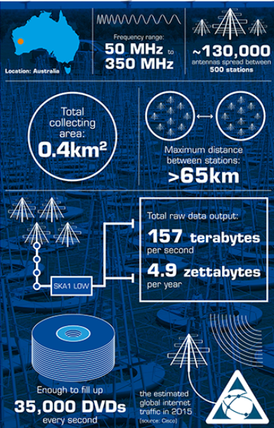
Astronomical Data
Hubble Space Telescope
Hubble transmits about 120 gigabytes of science data every week.
That's equal to about 3,600 feet (1,097 meters) of books on a shelf.
The rapidly growing collection of pictures and data is stored on magneto-optical disks.
Murchison Widefield Array
A radio telescope based in Western Australia’s Mid West, the Murchison Widefield Array (MWA), generates 157 TBs per second of data.
Back in 2013 Prof. Wicenec, Skatelescope, stated: “To store the Big Data the MWA produces, you’d need almost three 1 TB hard drives every two hours”
Phase II launched in April 2018 that doubled the number of antennas and resolution!
Notes:
http://hubblesite.org/the_telescope/hubble_essentials/quick_facts.php
https://www.skatelescope.org/news/pawsey-centre/
http://casu.ast.cam.ac.uk/casuadc/
http://www.noao.edu/meetings/bigdata/
http://hubblesite.org/the_telescope/team_hubble/
http://hla.stsci.edu/
http://www.mwatelescope.org/

Slide 15
Lots of other sources
Big data may come from lots of other sources:
A supermarket could use their loyalty card data, plus monitor social media sites to get an overall view of customer behaviour and preferences.
Hospitals analyse medical data and patient records to predict those patients that are likely to seek readmission within a few months of discharge. The hospital can then intervene in hopes of preventing another costly hospital stay.
Financial Services organisations are using data mined from customer interactions to slice and dice their users into finely tuned segments, so they make any offers more relevant to the customer.
Notes:
http://www.acquia.com/examples-big-data-projects
http://kognitio.com/nectar-card-operator-selects-kognitio-wx2-virtual-data-warehouse-appliance-to-transform-data-analytics/

Slide 16
Characteristics of Big Data
Volume - Data at rest (too big)
Variety - Data in many forms (too complex)
Velocity -Data in motion(too fast)
Veracity - Data in doubt(uncertainty)
Value - Data into money

Slide 17
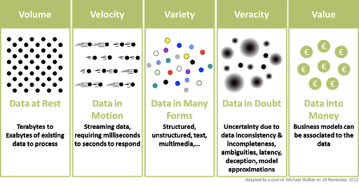
Characteristics of Big Data

Slide 18
Volume: Scale of Data
Refers to the vast amounts of data generated every second.
We are not talking Terabytes but Brontobytes or Geopbytes.
If we take all the data generated in the world between the beginning of time and 2008, the same amount of data will soon be generated every minute.

Slide 19
Variety: Different Forms of Data
This refers to the different types of data we can now use.
In the past we focused on structured data that fits neatly into tables or relational databases, such as financial data.
In fact, 80% of the world’s data is unstructured (text, images, video, voice, etc.)
Big data technology means we can now analyse and bring together data of different types such as messages, social media conversations, photos, sensor data, video or voice recordings.

Slide 20
Velocity: Analysis of Streaming Data
Refers to the speed at which new data is generated and the speed at which data moves around.
Just think of social media messages going viral in seconds.
Technology allows us now to analyse the data while it is being generated (in-memory analytics), without ever putting it into databases.

Slide 21
Veracity: Uncertainty of Data
Refers to the messiness or trustworthiness of the data.
With many forms of big data, quality and accuracy are less controllable
Big data and analytics technology now allows us to work with these type of data.

Slide 22
Value: Turning Big Data into Value
Having access to big data is no good unless we can turn it into value.
Companies are starting to generate amazing value from their big data.

Slide 23
Big Data Trends 2024
Stream Processing Enables Real-Time Big Data Insights
AI And ML Power Automation And Analytics
Data-As-A-Service Offers Scalable, Cost-Effective Management
Data Lakes And Lakehouses Provide Optimized Storage
Transitions In Big Data Governance

Slide 24
Big Data Applications
Healthcare
Manufacturing
Media & Entertainment
Internet of Things (IoT)
Government
Ecommerce
Disaster Management
Digital Marketing
Telecommunication
Retail Industry
Finance
Education

Slide 25
Some Big Data Use Cases
Credit Card Fraud Detection
Sentiment Analysis
Delivering personalized customer experience
Preventing customer churn
Genomic Research

Slide 26
How is Big Data Used
Understanding and Targeting Customers
Understanding and Optimizing Business Processes
Improving Sports Performance
Improving and Optimizing Cities and Countries
Improving Healthcare and Public Health
https://www.bernardmarr.com/default.asp?contentID=1076

Slide 27
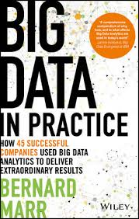
Big Data in Practice

Slide 28
Big Data in COVID-19 Pandemic
Identification of infected cases
Travel history
Fever symptoms
Identification of the virus at an early stage
Identification and analysis of fast-moving disease
Information during lockdown
People entered or leaving the affected area
Faster development of medical treatments

Slide 29
Role Of Big Data In The Fight Against COVID-19
China’s Surveillance Infrastructure Used to Track Exposed People
Mobile App for Contact Tracing
Official Dashboards Track the Virus and Outbreak Analytics
Big Data Analytics and Successes in Taiwan
https://www.linkedin.com/pulse/vital-role-big-data-fight-against-covid-19-coronavirus-bernard-marr

Slide 30
Scope of Big Data
Increasing demand for Data Analytics
Increasing enterprise adoption of Big Data
Big Data finds application across various parallels of the industry
Huge Job Opportunities & Meeting the Skill Gap
Promises exponential salary growth
Key Decision-Making Power

Slide 31
Challenges of Big Data
Dealing with data growth
Generating insights in a timely manner
Recruiting and retaining big data talent
Integrating disparate data sources
Securing big data
Organizational resistance

Slide 32
Summary
Big data is a big research area currently
The data generated will not be going away anytime soon, so need an effectively way of handling it
We have looked at the various Vs associated with Big Data
Many more can be found online!

Slide 33
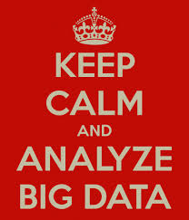
Thank You !

